Slide 1
Title: SALES ANALYSIS OF NEW PRODUCT LINE
SUBTITLE:
Evaluating Sales Strategies for Optimal Revenue Growth.

Slide 2
Table of Contents
Title Slide
Introduction
Dataset Overview
Data Cleaning & Validation
Number of Customers Per Sales Method
Revenue Distribution (Overall & Per Method)
Revenue Trends Over 6 Weeks
Business Metric for Monitoring Sales
Conclusion & Recommendation

Slide 3
INTRODUCTION
Objective: Identify the best sales method for increasing revenue and customer engagement.
Sales Methods Tested: Email, Call, Email + Call.
Why This Matters: A strategic sales approach helps in optimizing resources and maximizing sales.

Slide 4
DATASET OVERVIEW
Dataset Overview
Data Source: Sales Tracking System
Key Columns:
Week of Sale
Sales Method
Customer ID
Number of Products Sold
Revenue
Years as Customer
Website Visits
Customer Location

Slide 5
DATA CLEANING & VALIDATION
Issues Found & Fixes:
Missing Revenue Values → Replaced with average revenue per sales method.
Inconsistent Sales Method Labels → Standardized to three categories.
Invalid Customer Years (47 & 63) → Capped at 39 years (company founded in 1984).
Final Clean Dataset: 15,000 rows, no missing values.

Slide 6
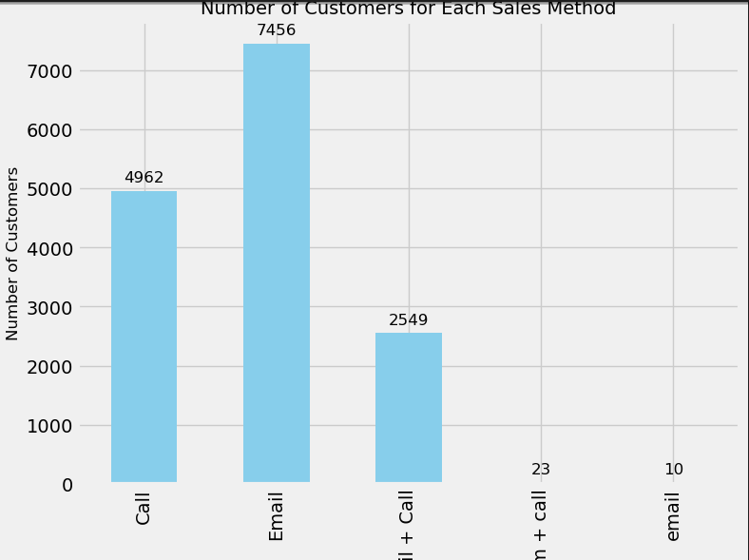
NUMBER OF CUSTOMERS PER SALES METHOD
Breakdown:
Email: 5,000 customers
Call: 5,000 customers
Email + Call: 5,000 customers
Graph: Bar chart showing customer count per method.

Slide 7
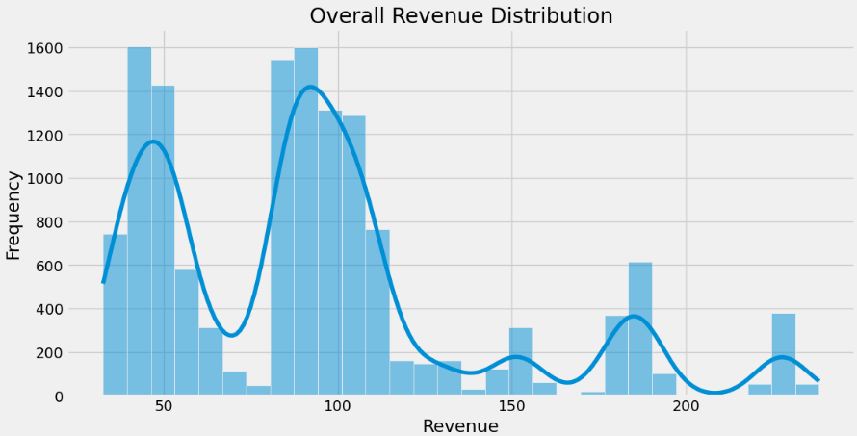
REVENUE DISTRIBUTION (OVERALL & PER METHOD)
Key Observations:
Overall revenue follows a right-skewed distribution.
Email: High initial revenue but declines over time.
Call: Fluctuating revenue, decreasing trend.
Email + Call: Consistent revenue growth.
Graph: Histogram + Boxplot comparing revenue distributions.

Slide 8
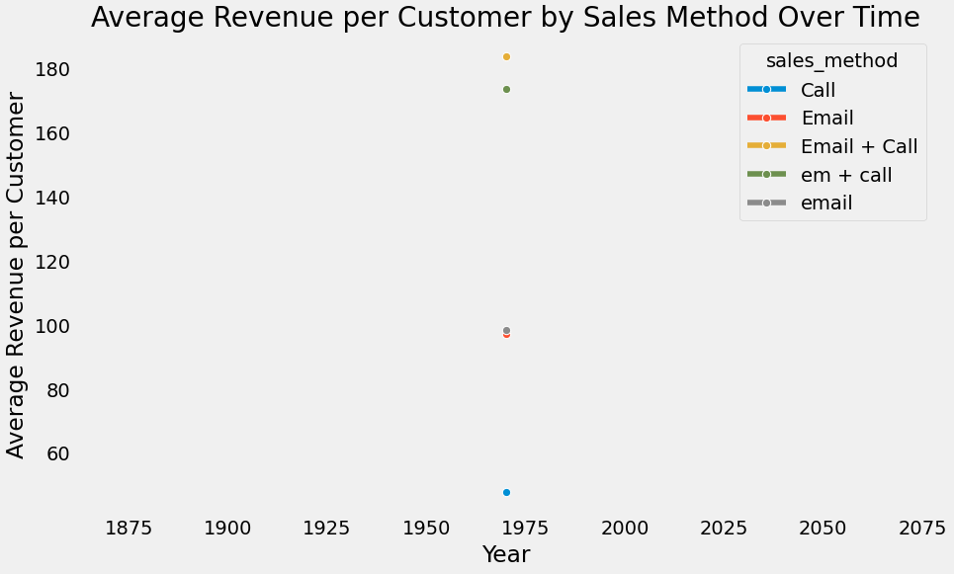
REVENUE TRENDS OVER 6 WEEKS
Key Trends:
Email → Declining revenue trend.
Call → Inconsistent performance.
Email + Call → Steady increase in revenue.
Graph: Line plot showing revenue trends over time.

Slide 9
BUSINESS METRIC FOR MONITORING SALES
Revenue per Effort (RPE):
Initial Estimates:
Email: Low effort, declining revenue.
Call: High effort, unstable revenue.
Email + Call: Balanced effort, highest revenue growth.

Slide 10
CONCLUSION & RECOMMENDATION
Best Sales Method: Email + Call
Highest revenue growth over time.
Better customer engagement (higher website visits, more purchases).
Sustainable in the long run.
Actionable Steps:
Prioritize Email + Call for new product launches.
Automate emails to reduce manual work.
Use targeted calls for high-value customers.
Monitor Revenue per Effort (RPE).

Slide 11


